Slide 1
IMAGE CLASSIFIER
Scraping and recognition

Slide 2
TASKS
Data Collection –
Web Scraping of 200 images of
Womens Sarees,
Mens Jeans,
Mens Trousers.
Image Classification –
Building a deep learning model to classify images between 3 categories.

Slide 3
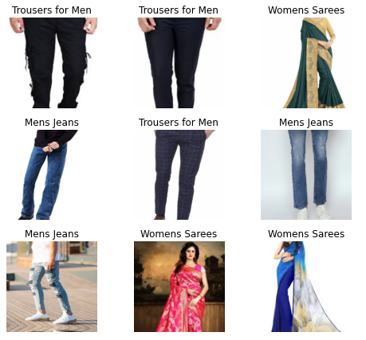
EDA

Slide 4
MODEL BUILDING
Image recognition through Transfer Learning
Using ResNet18 Convolutional Neural network.

Slide 5
CONCLUSION
Model performance through confusion matrix.
Values in diagonal fields of the matrix ➔ correct predictions

